Slide 1

The Mobile Paradigm
-Lecturer: Matthew Elvey
-Presenter: Anish Bastakoti
This Photo by Unknown Author is licensed under CC BY-SA-NC

Slide 2
Product Concept
Can order Books
Search Different Books
Cancel order even after placing it

Slide 3
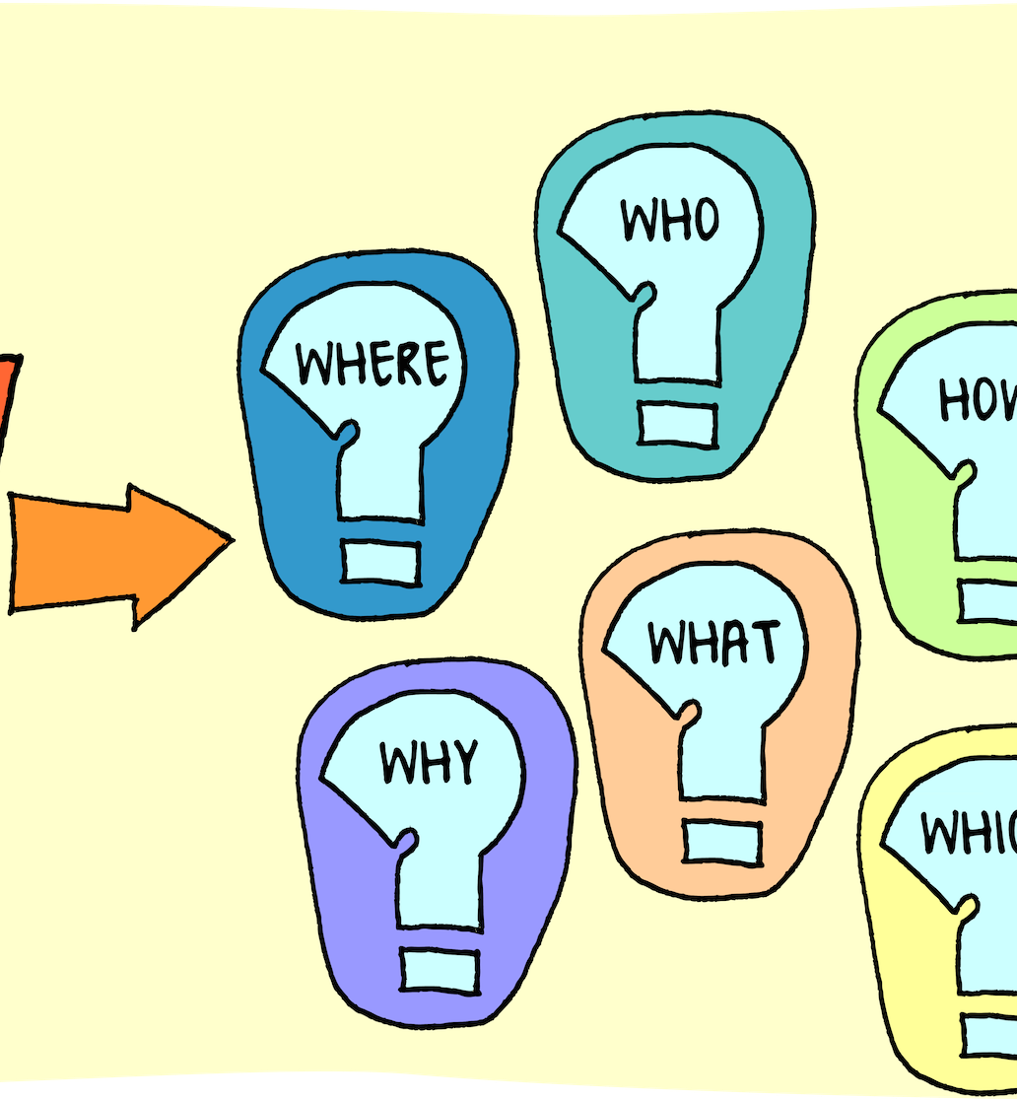
Problem Statement
People of age 18 or above
Not any proper Mobile app/PWA for book ordering
Does not Support Local store
This Photo by Unknown Author is licensed under CC BY

Slide 4
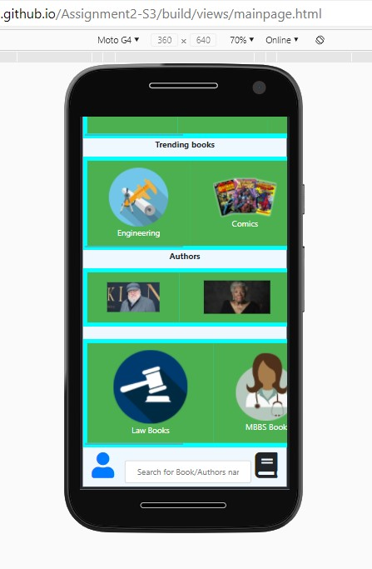
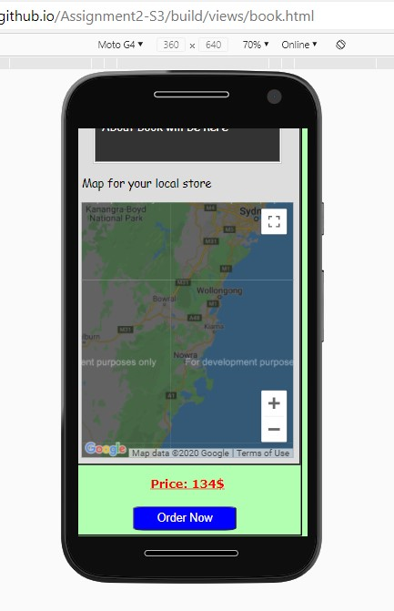
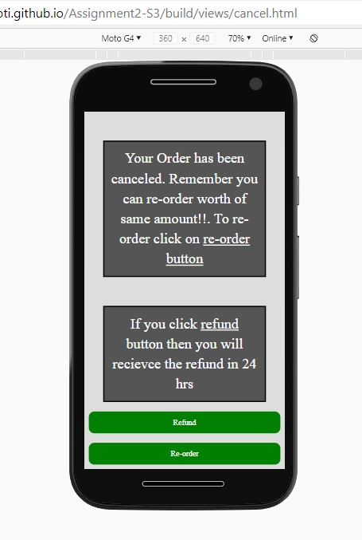
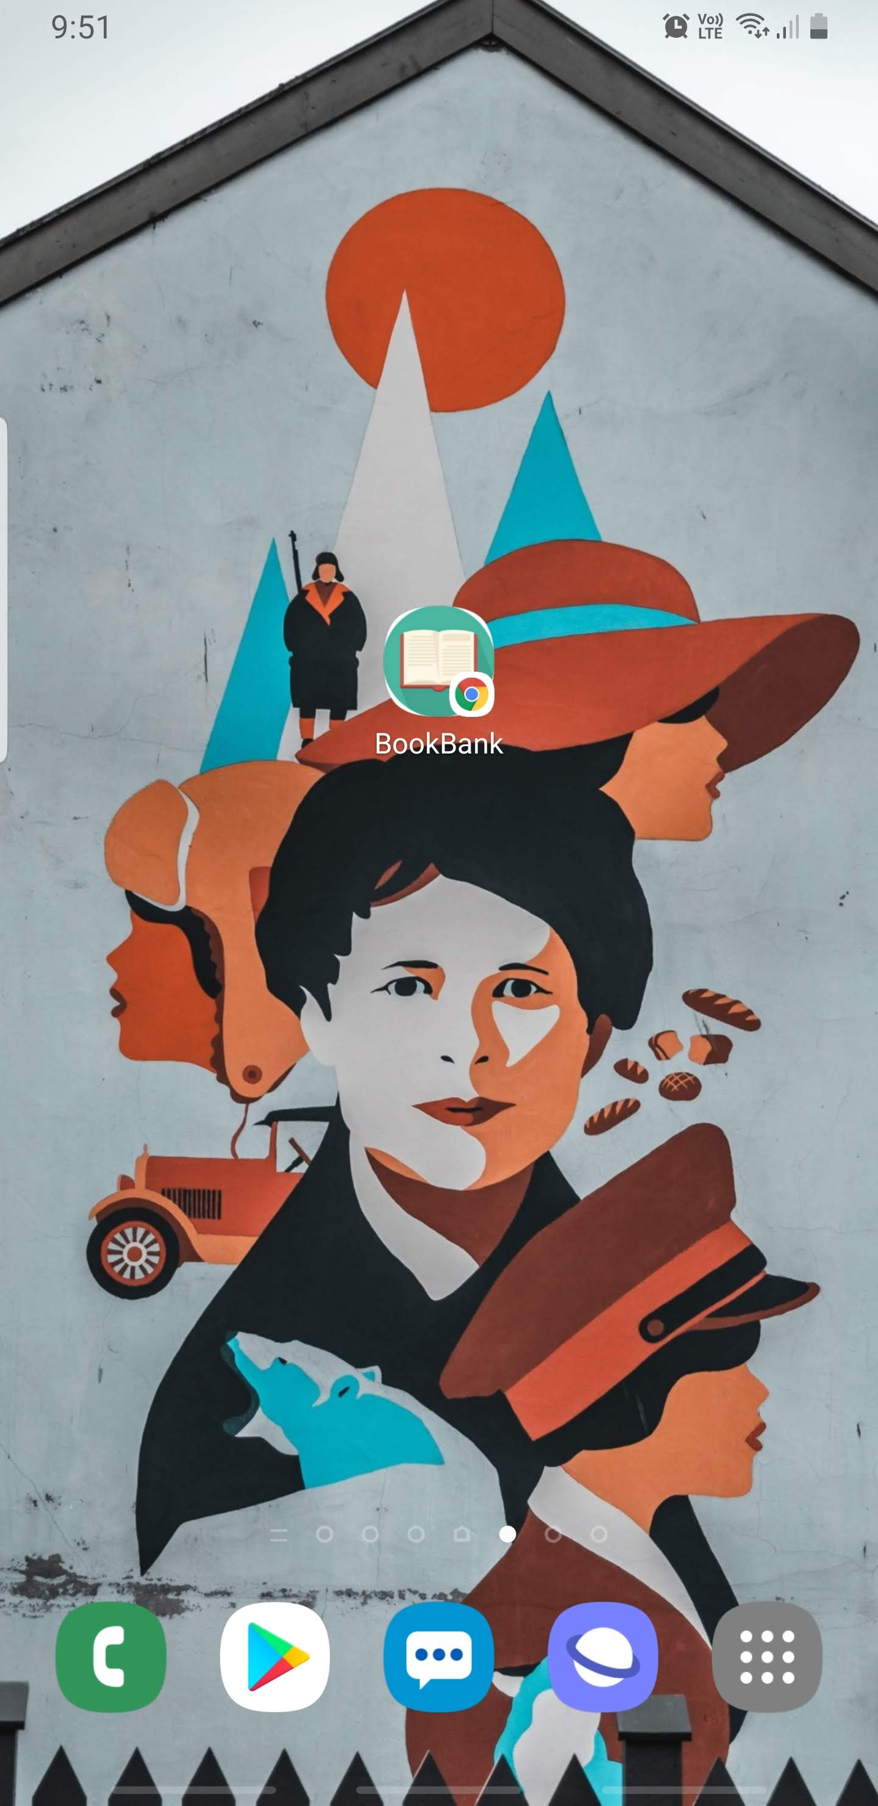
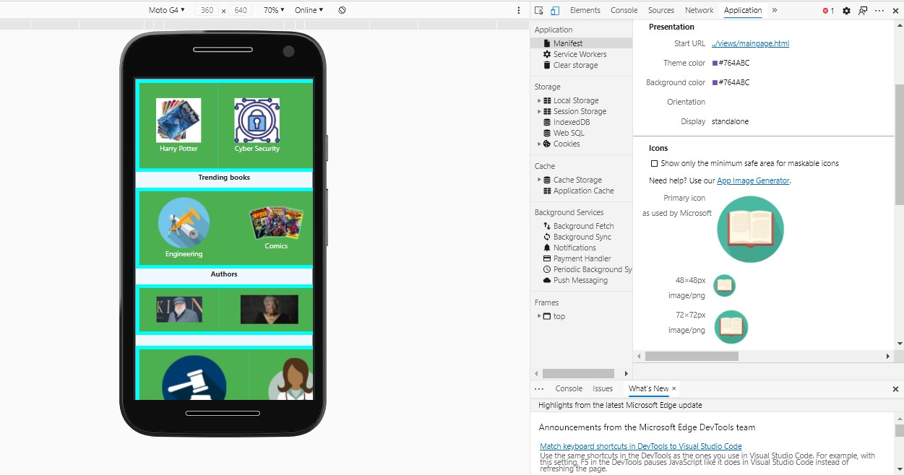
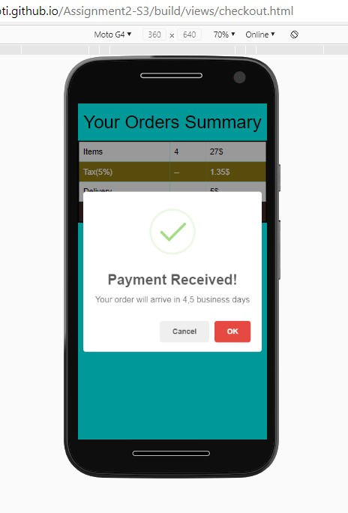
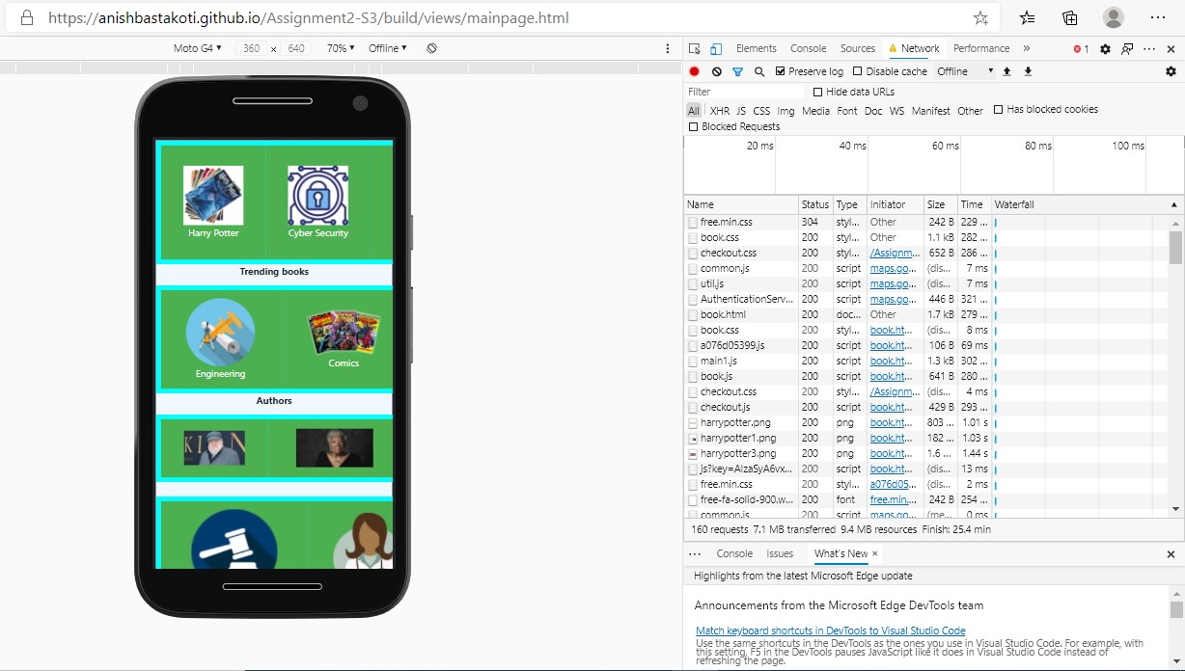
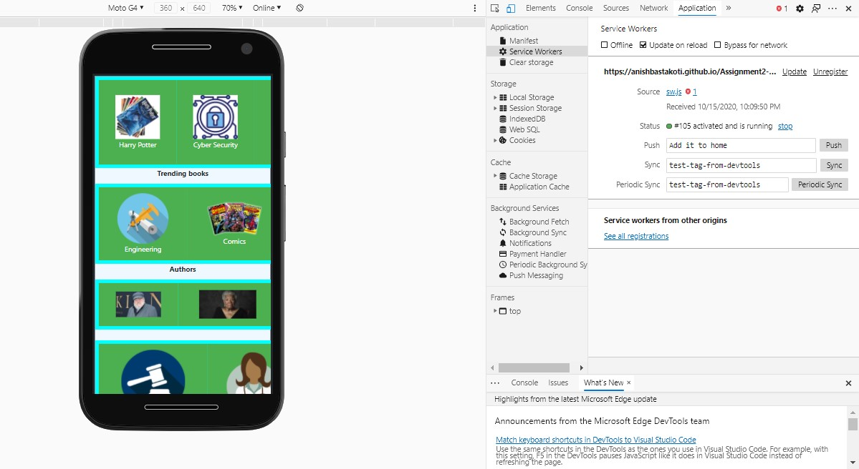
Product Features
Can search book
Support local store
Cancel order even after placing it
PWA application
Add to Home Screen

Slide 5

Any Questions
This Photo by Unknown Author is licensed under CC BY-NC-ND

Slide 6

Thank You

